Slide 1
Final Project
An Implementation of Monocular Visual Odometry
Mingxin Dong
326006087

Slide 2
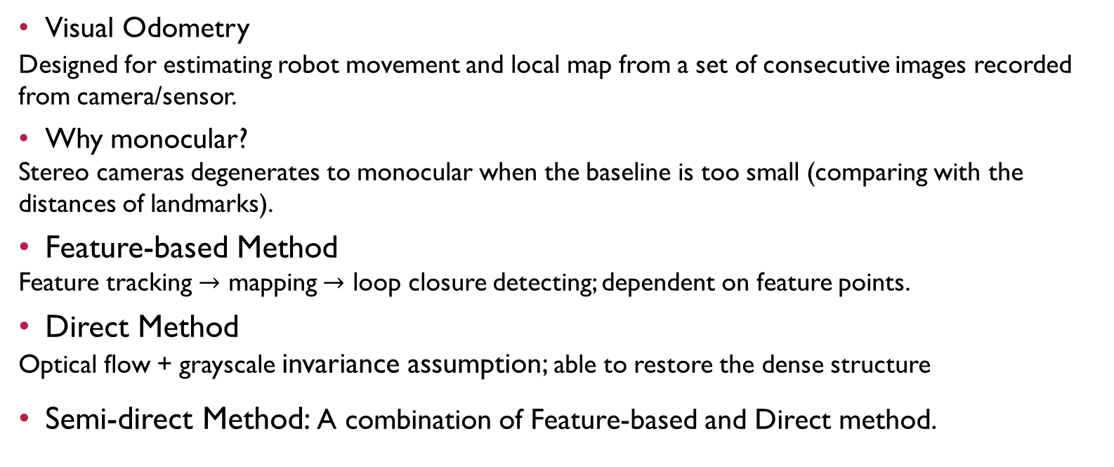
Introduction
Visual Odometry
Designed for estimating robot movement and local map from a set of consecutive images recorded from camera/sensor.
Why monocular?
Stereo cameras degenerates to monocular when the baseline is too small (comparing with the distances of landmarks).
Feature-based Method
Feature tracking $→$ mapping $→$ loop closure detecting; dependent on feature points.
Direct Method
Optical flow + grayscale invariance assumption; able to restore the dense structure
Semi-direct Method: A combination of Feature-based and Direct method.

Slide 3
BACKGROUND
Monocular Camera Model
Feature Detection
Feature Tracking
Pose Estimation

Slide 4
BACKGround - camera
Monocular Camera Model
Intrinsic matrix K, extrinsic matrices R, t
Distortion
Camera parameters for KITTI dataset is listed in “calib.txt”
Notes:
Geometrically, pinhole camera model follows the properties of homologous triangles.

Slide 5
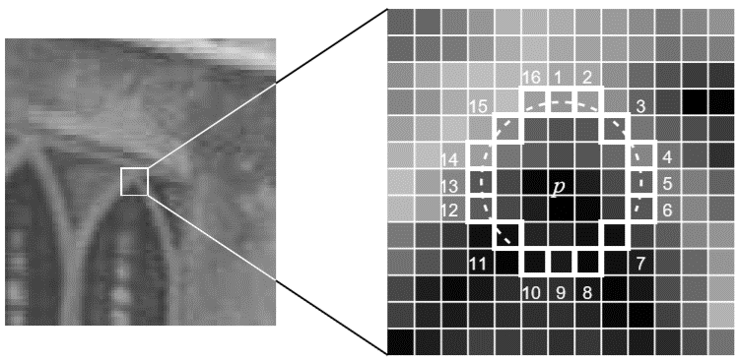
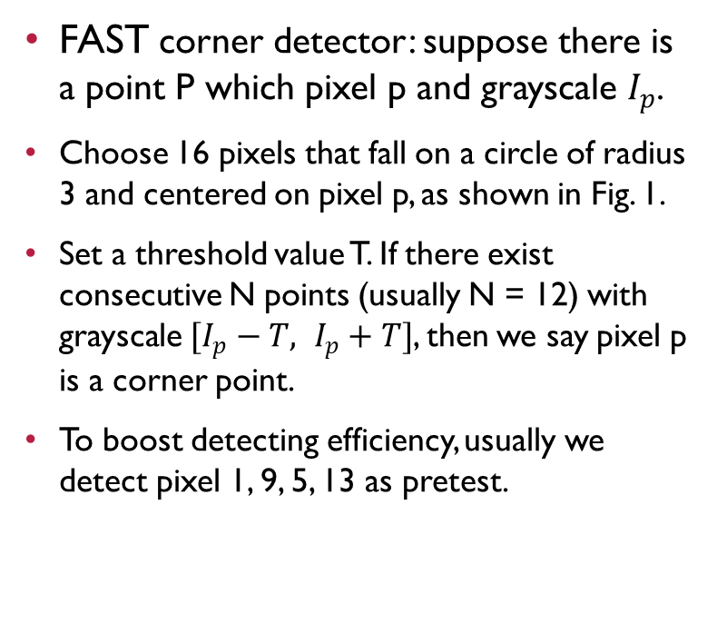
Background – feature detection
FAST corner detector: suppose there is a point P which pixel p and grayscale $I_{p}$.
Choose 16 pixels that fall on a circle of radius 3 and centered on pixel p, as shown in Fig. 1.
Set a threshold value T. If there exist consecutive N points (usually N = 12) with grayscale $[I_{p}−T, I_{p}+T]$, then we say pixel p is a corner point.
To boost detecting efficiency, usually we detect pixel 1, 9, 5, 13 as pretest.
Fig 1. Image illustrating FAST algorithm taken from original paper [4].

Slide 6
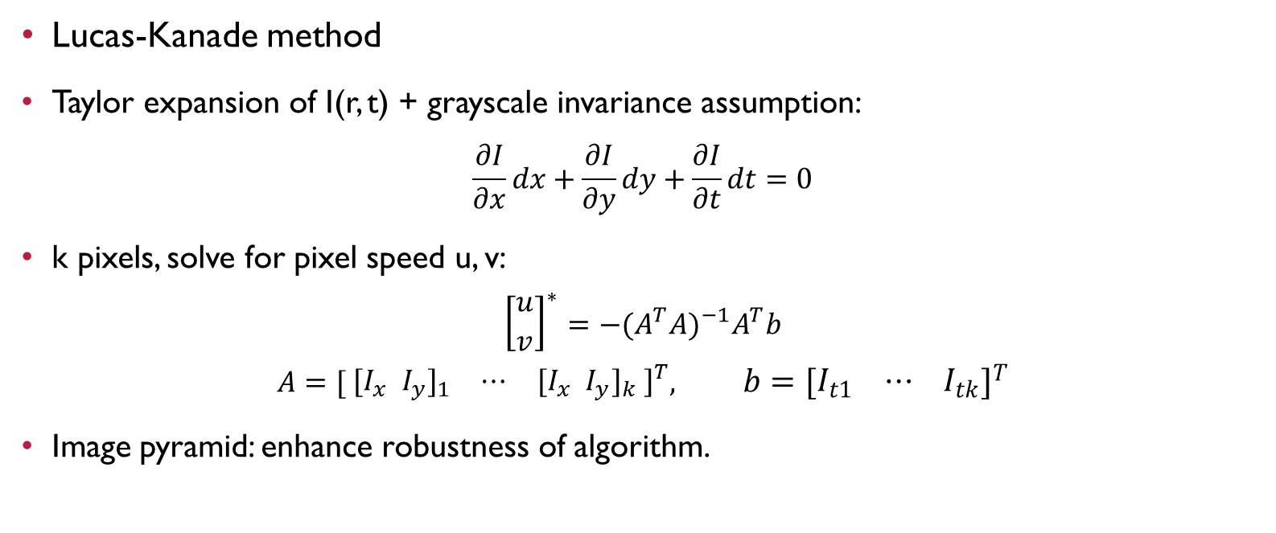
Background – feature tracking
Lucas-Kanade method
Taylor expansion of I(r, t) + grayscale invariance assumption:
$$\frac{∂I}{∂x}dx+\frac{∂I}{∂y}dy+\frac{∂I}{∂t}dt=0$$
k pixels, solve for pixel speed u, v:
$${\left[\begin{matrix}u \\ v\end{matrix}\right]}^{∗}=−{(A}^{T}A)^{−1}A^{T}b$$
$$A=[ \begin{matrix}{[I}_{x} I_{y}]_{1} & ⋯ & {{[I}_{x} I_{y}]}_{k} ]^{T}\end{matrix}, b=[\begin{matrix}I_{t1} & ⋯ & I_{tk}\end{matrix}]^{T}$$
Image pyramid: enhance robustness of algorithm.
$$\min_{∆x, ∆y}={\left\|I_{1}\left(x,y\right)−I_{2}\left(x , +∆x, y+∆y\right)\right\|}_{2}^{2}$$

Slide 7
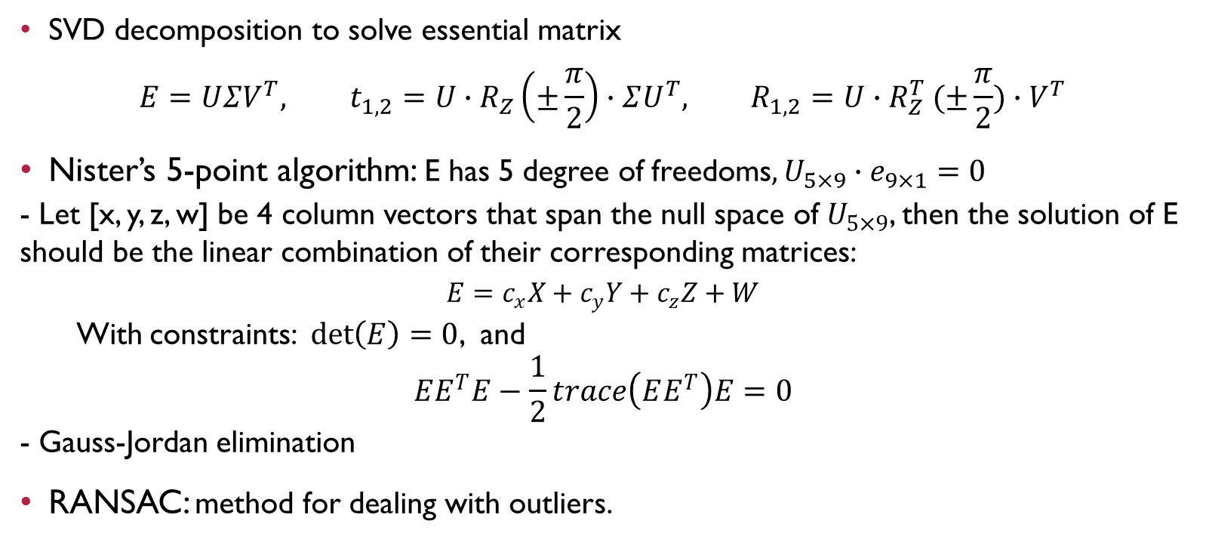
Background – pose estimation
SVD decomposition to solve essential matrix
$$E=UΣV^{T}, t_{1,2}=U∙R_{Z}\left(±\frac{π}{2}\right)∙ΣU^{T}, R_{1,2}=U{∙R}_{Z}^{T}(±\frac{π}{2}){∙V}^{T}$$
Nister’s 5-point algorithm: E has 5 degree of freedoms$,U_{5×9}∙e_{9×1}=0$
- Let [x, y, z, w] be 4 column vectors that span the null space of $U_{5×9}$, then the solution of E should be the linear combination of their corresponding matrices:
$$E=c_{x}X+c_{y}Y+c_{z}Z+W$$
With constraints: $\det\left(E\right)=0$, and
$$EE^{T}E−\frac{1}{2}trace\left(EE^{T}\right)E=0$$
- Gauss-Jordan elimination
RANSAC: method for dealing with outliers.

Slide 8
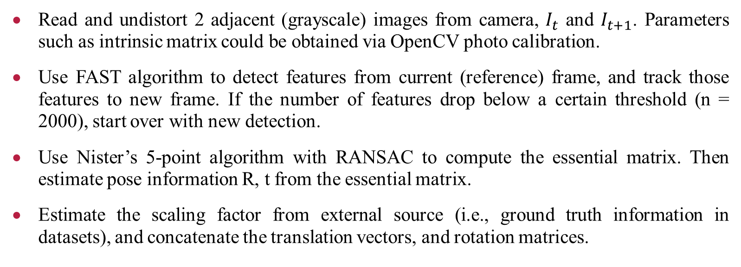
IMPLEMENTATION
Read and undistort 2 adjacent (grayscale) images from camera, $I_{t}$ and $I_{t+1}$. Parameters such as intrinsic matrix could be obtained via OpenCV photo calibration.
Use FAST algorithm to detect features from current (reference) frame, and track those features to new frame. If the number of features drop below a certain threshold (n = 2000), start over with new detection.
Use Nister’s 5-point algorithm with RANSAC to compute the essential matrix. Then estimate pose information R, t from the essential matrix.
Estimate the scaling factor from external source (i.e., ground truth information in datasets), and concatenate the translation vectors, and rotation matrices.

Slide 9
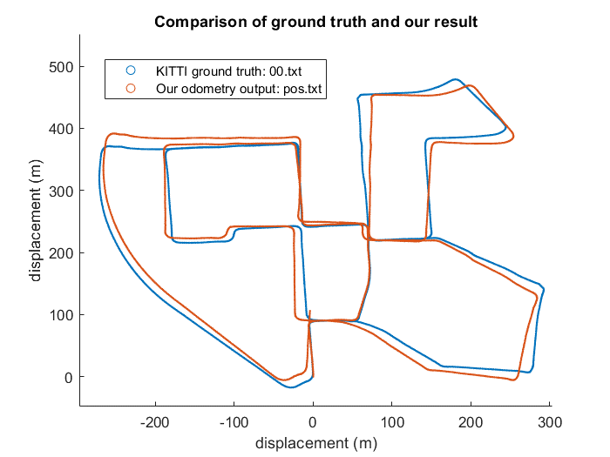
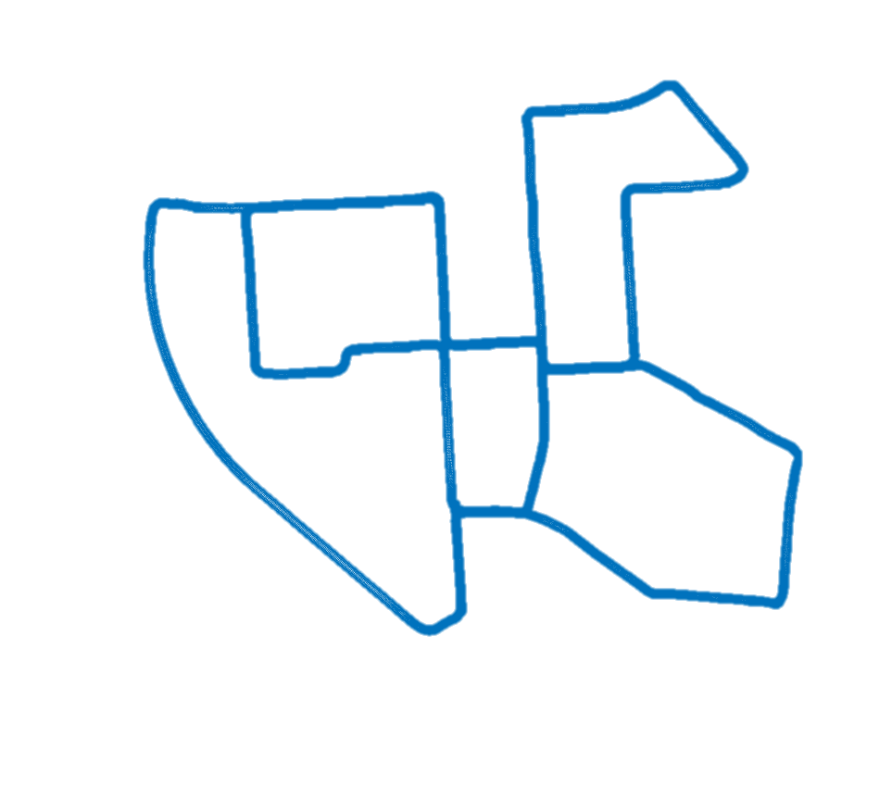
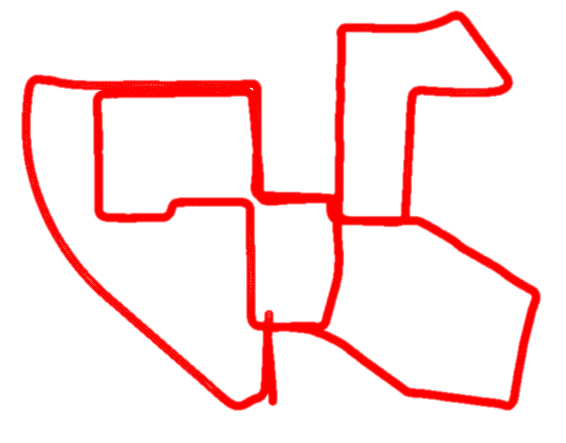
RESULTS
Notes:
We have chosen one of the most challenging sequences of the KITTI visual odometry benchmark (sequence 00) to testify our algorithm. From the comparison shown in Fig. 2, it could be observed that the local mapping information we calculated is consistent with the ground truth information provided in the KITTI dataset. The cumulative error could not be eliminated without backend optimization, but generally speaking, the performance of our MVO is satisfactory for a single loop.
The processing time for the whole sequence (4540 frames) is around 9 minutes, therefore it took about 0.12s on average for our MVO to process one single frame. The program is compiled serially, with an Intel i7-9750H 2.6GHz CPU.

Slide 10
Summary and FUTURE WORK
A monocular visual odometry algorithm and its running results on the KITTI dataset have been presented. The loop results remained within reasonable error bounds. The image processing speed is approximately 8.3 fps.
For future work, we plan to add backend modules to our visual odometry. The backend should include optimization (bundle adjustment), loop closure detection, map construction and storage.

Slide 11
Thank you Very much

